Slide 1
Chart Control Design
Systems Product Division
Agilent Restricted
August, 03 2007

Slide 2
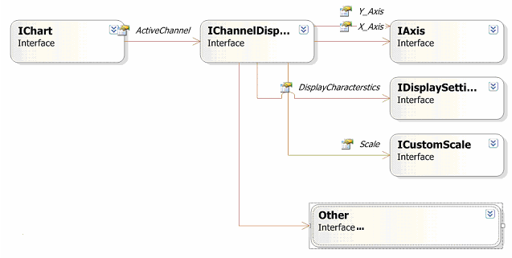
High Level Chart Control Design
Loose coupling by using interface
Extendible, new functionalities can be added easily
Composition is favored over inheritance
Focus on flexibility, can be modified easily

Slide 3
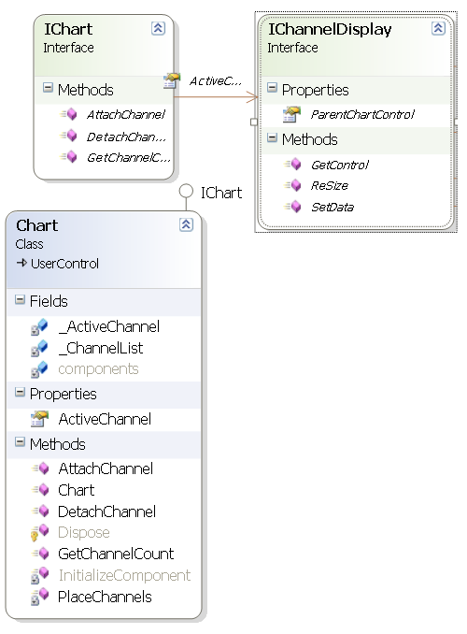
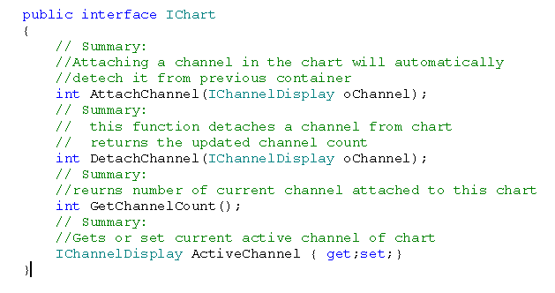
Chart Class
Chart class is derived from the user control
Has all the functionality of .net usercontrol
Can be placed on the form just like any other control
Easy to access and modify attributes like Size, Backcolor, Docking etc.
Contains multiple channels,can be added or removed easily

Slide 4
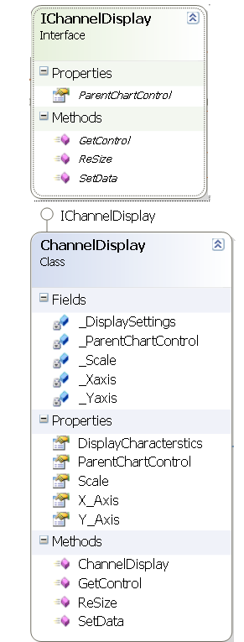
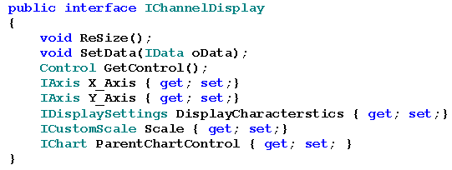

Channel Display Class
Contains references to the other objects which provide implementation to modify various attributes.
ChannelDisplay object can be created and attached easily to the chart.

Slide 5
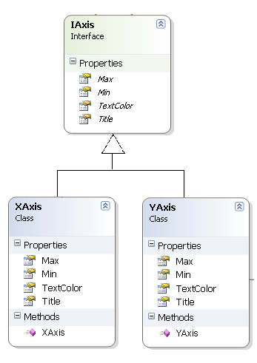
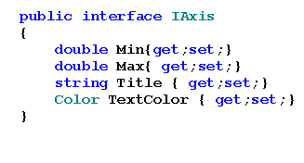
IAxis Implementation
X-Axis and Y-Axis Acts as a wrapper class on the trace control. All the calls made on these objects is forwarded to appropriate function of Trace Control
User can set Min, Max, Title text and text color of ChannelDispay
Contained in the ChannelDisplayObject

Slide 6
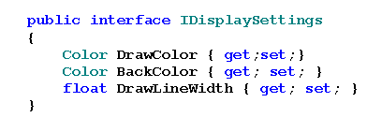
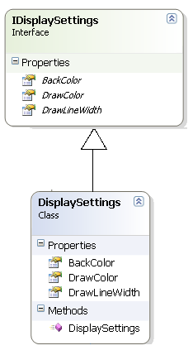
IDisplaySetting Implementation
Class act as a wrapper class on the trace control.
Provide all common display related settings
Contained in the ChannelDisplay Object
New Methods can be added easily

Slide 7
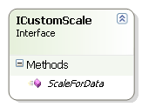
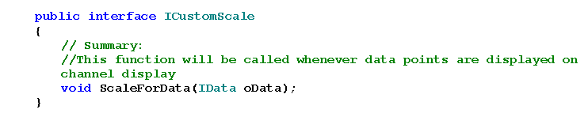
ICustomScale
Allow the user to implement his own scaling scheme.
Method ScaleForData is called from the ChannelDisplay
Implementation object is attached by user in ChannelDisplay Object.
contd…

Slide 8
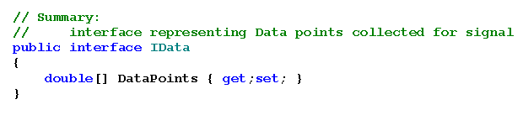
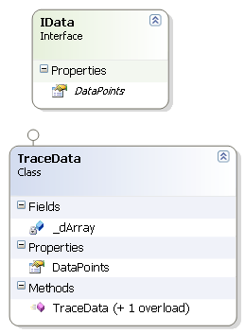
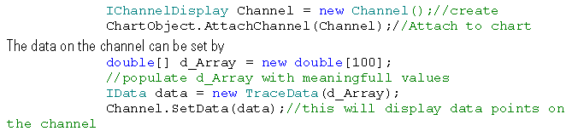
IData Interface

Slide 9
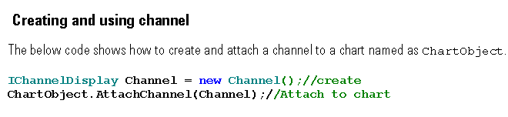
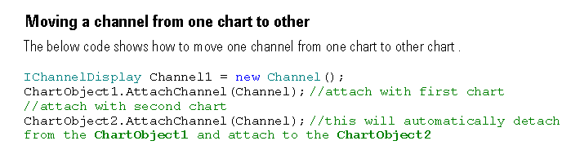
Usage

Slide 10
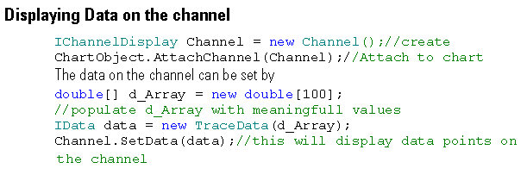
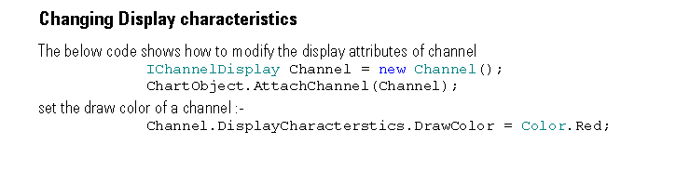
contd…

Slide 11
DISCUSSION
Q & A

